Slide 1
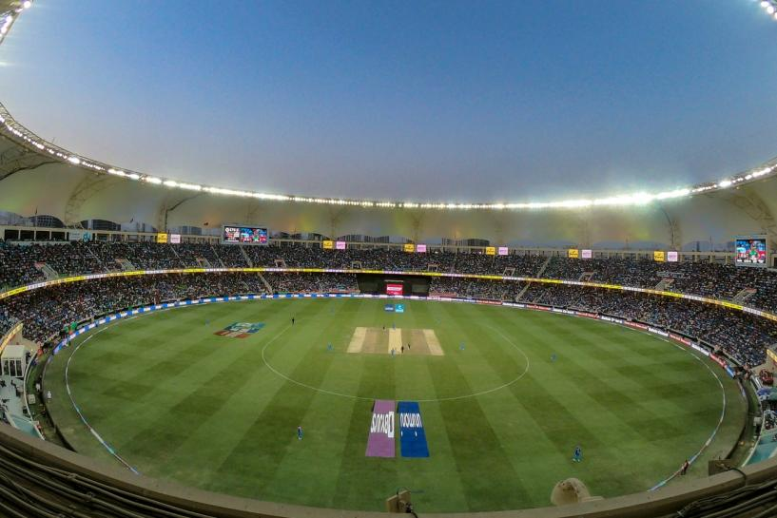
IPL ANALYSIS

Slide 2


PROBLEM DEFINITION :
To analyze the IPL dataset from 2008-2019 using statistical techniques in Python like measures of central tendency, correlation and regression, probability distributions, hypothesis testing, and conditional probability.
Also, to represent the data in the form of graphs and diagrams and draw conclusions from them.

Slide 3
SCOPE :
IPL analysis will help us to predict the runs to be scored by the players and check which player is consistent throughout , so that we can select the player for the team during auction. Also, we can check the truthfulness of our prediction using certain methods.
This can be done by implementing it in various programming languages like Python, R, etc using statistical functions that are available.

Slide 4
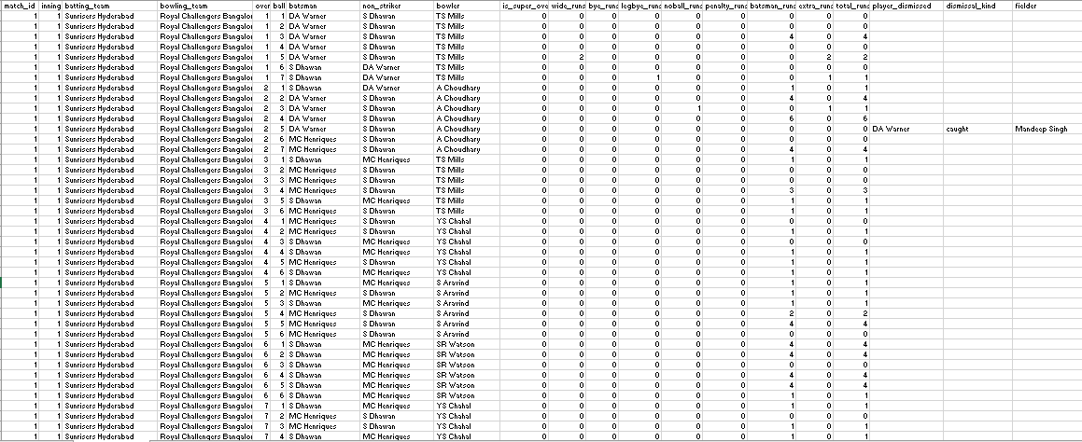
DATASET (DELIVERIES) :

Slide 5
The data in Deliveries represents ball by ball runs scored by the individual players.
The dataset consists of 20 columns and 179079 rows.
The columns has the following details:
Match id : The match id to uniquely identify each match.
Innings : One of the divisions of a cricket match during which one team takes its turn to bat.
Batting team : Name of the Batting teams.
Bowling team : Name of the Bowling teams.
Over : Number of overs bowled.
Ball : Count of balls bowled.
Batsman : Name of the Batsman.
Non striker : The name of the Batsman on the bowling end.
Bowler : Name of the Bowler.
Super Over : An extra over to determine the winner.
Wide runs : Extra runs awarded to the batting team for legside or offside ball.
Total runs : Total number of runs scored in the match.
Player dismissed : Name of the player dismissed.
Dismissal kind : Caught,Bowled,Leg before wicket,Run out and stump.
Fielder : Name of the fielder.

Slide 6
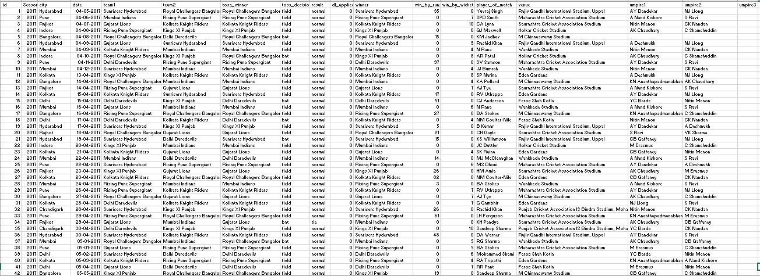
DATASET (MATCHES) :

Slide 7
The dataset describes the match wise data of individual teams.(756*18)
Id : The IPL match id.
Season : The IPL season
City : The city where the IPL match was held.
Date : The date on which the match was held.
Team1 : One of the teams of the IPL match
Team2 : The other team of the IPL match
Toss winner : The team that won the toss
Toss decision : The decision taken by the team that won the toss to ‘bat’ or ‘field’
Result : The result(‘normal’, ‘tie’, ‘no result’) of the match.
Dl applied : (1 or 0)indicates whether the Duckworth-Lewis rule was applied or not.
Winner : The winner of the match.
Win by runs : Provides the runs by which the team batting first won
Win by runs : Provides the number of wickets by which the team batting second won.
Player of match : The outstanding player of the match.
Venue : The venue where the match was hosted.
Umpire1 : One of the two on-field umpires who officiate the match.
Umpire2 : One of the two on-field umpires who officiate the match.
Umpire3 : The off-field umpire who officiates the match

Slide 8
CONCEPTS USED :
MEAN :
Mean is the sum of collection of numbers divided by the count of numbers in the collection.
STANDARD DEVIATION :
Standard Deviation is a measure of amount of variation or dispersion of set of values,low standard deviation indicates that the values tend to be close to the mean of the set,while high standard deviation indicates that the values are spread out over a range.
CORRELATION :
Correlation is a statistical measure that expresses the extent to which two variables are linearly related.The correlation coefficient r, quantifies the strength of the relation.
REGRESSION :
Regression is a statistical method that attempts to determine the strength of the relationship between one dependent variable and one or more independent variables. By the way they contribute and are related to producing a particular outcome together.

Slide 9
PROBABILITY DISTRIBUTIONS:
DISCRETE RANDOM DISTRIBUTIONS:
BERNOULLI DISTRIBUTION:
A Bernoulli distribution is a discrete probability distribution for a Bernoulli trial - a random experiment that has only two outcomes (usually called a “Success” or a “Failure”). The probability of “success” is P and probability of “failure” is 1-P. It is a special case of the binomial distribution for n = 1.
CONTINUOUS RANDOM DISTRIBUTIONS:
UNIFORM DISTRIBUTION:
In statistics, uniform distribution is a term used to describe a form of probability distribution where every possible outcome has an equal likelihood of happening. The probability is constant since each variable has equal chances of being the outcome.

Slide 10
GRAPHS :
Graphs are the pictorial representation of the data. We have used graphs to depict the conclusions of the above distributions.
CONDITIONAL PROBABILITIES:
The conditional probability of the event is the probability that the event will occur, provided the information that an event A has already occurred.
HYPOTHESIS TESTING:
Z – TEST :
The sample size n is greater than 30 (n≥30) it is known as large sample. For large samples , the sampling distributions of statistic are normal(Z test).
A z-test is a statistical test used to determine whether two population means are different when the variances are known and the sample size is large.

Slide 11
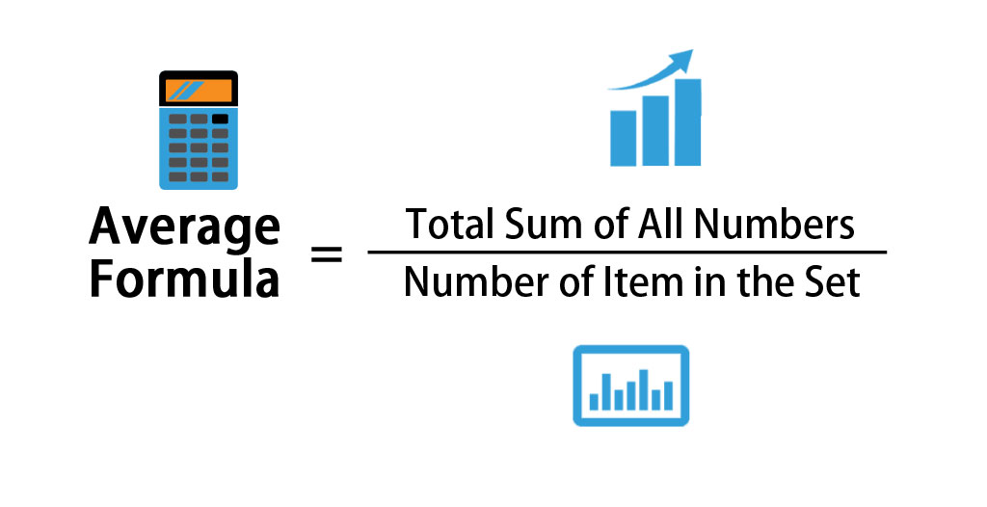
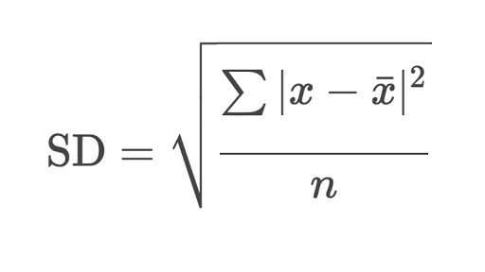
CALCULATION:
MEAN :
Python function: mean()
STANDARD DEVIATION:
Python function: std()

Slide 12
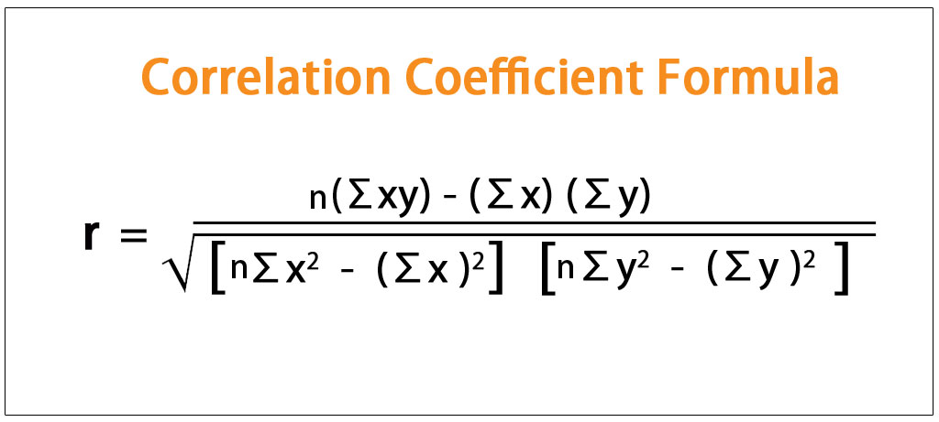
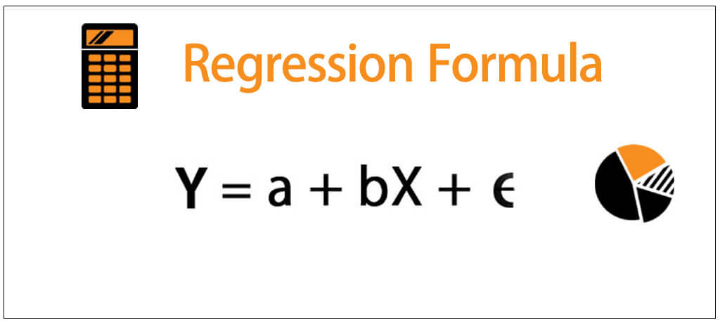
CORRELATION :
Python function: corr()
REGRESSION :
Python function: LinearRegression()

Slide 13
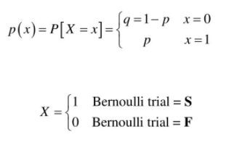

BERNOULLI DISTRIBUTION :
Python function: Bernoulli. rvs (parameters)

Slide 14
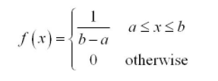
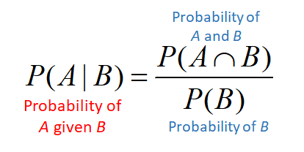
UNIFORM DISTRIBUTION:
Python function: uniform(parameters)
CONDITIONAL PROBABILITES:
No direct Python function

Slide 15
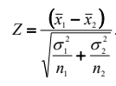
HYPOTHESIS TESTING:
Z-TEST:
Python function: critical z-value: norm. ppf(parameter)
z-test value: ztest (parameters)

Slide 16

ALGORITHM:
The dataset is extracted from Kaggle.
Importing the dataset into python jupyter notebook using pandas.
Followed by importing, data cleaning process is held out.
Mean is calculated by both team wise and player wise.
Standard deviation is calculated to measure the average distance between the values of the data in the set and the mean.
In order to know the relation between the two variables correlation is calculated.
Correlation is visualized with the help of the Scatter plot.
Finally, regression is calculated to predict the future status.

Slide 17
Top 10 players of the match, winning percentage of the CSK, average runs in each over, total matches in each city, total wins by each team are represented graphically.
Various probability distributions are implemented for the data like, Bernoulli, and continuous uniform distributions.
Next, we made some conclusions from conditional probabilities, i.e, finding the probability of a event, given an event has already occurred.
Then, hypothesis test was carried out for testing of the dataset.
Z-test was carried out for large sample sizes.
Run the program at each levels.

Slide 18
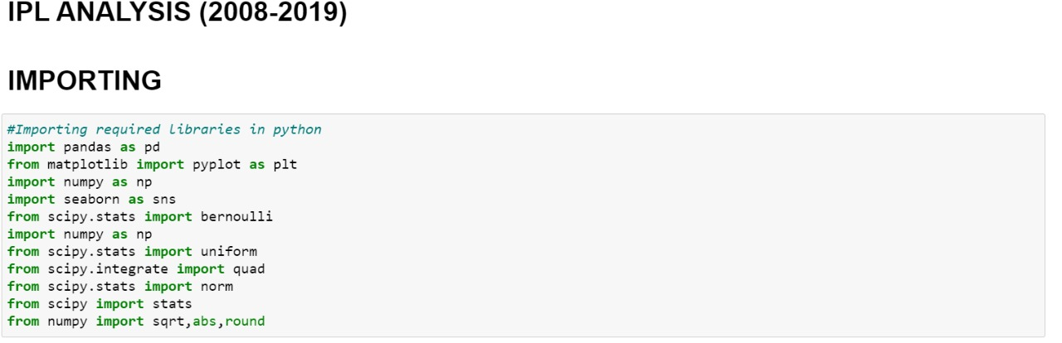
CODING & OUTPUT :
IMPORTING THE LIBRARIES :
IMPORTING THE DATASET :

Slide 19
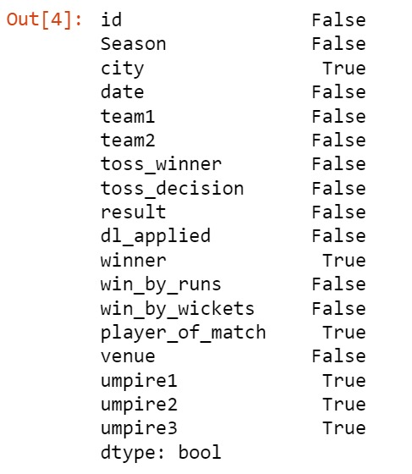
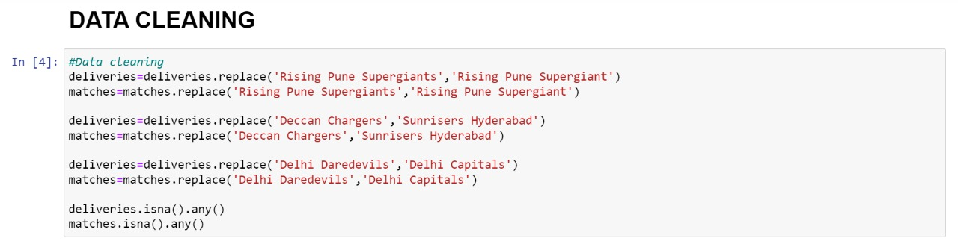
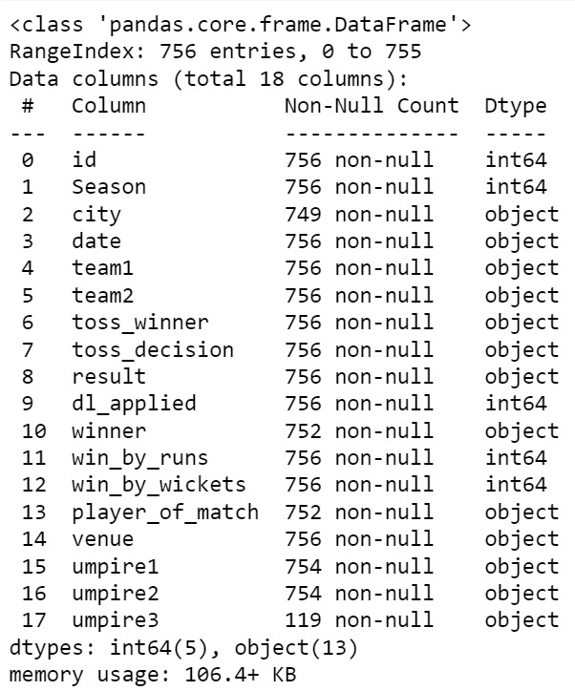
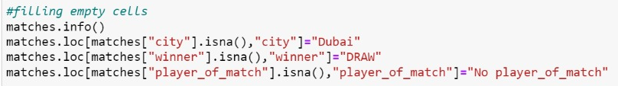
DATA CLEANING :

Slide 20
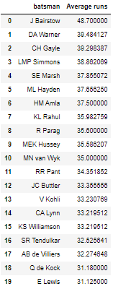
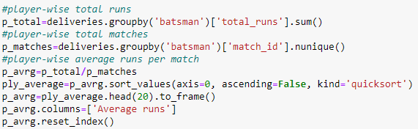
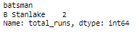
AVERAGE RUNS PER MATCH (Player-wise):

Slide 21
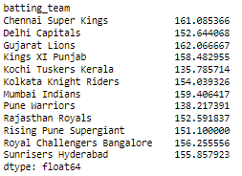
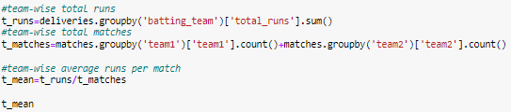
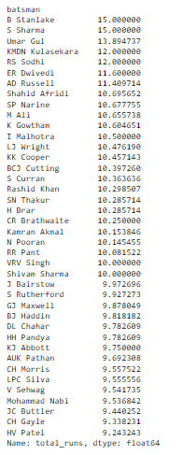
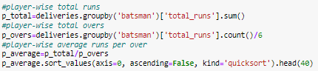
AVERAGE RUNS PER MATCH (Team-wise)
AVERAGE RUNS PER OVER (Player-wise)

Slide 22
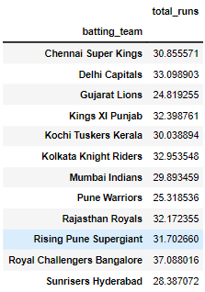
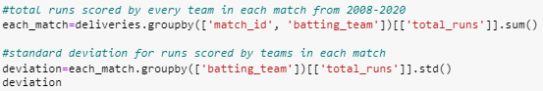
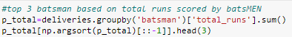
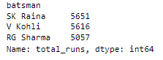
STANDARD DEVIATION (for runs scored by teams in each match)
TOP 3 BATSMEN

Slide 23
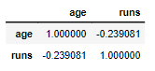
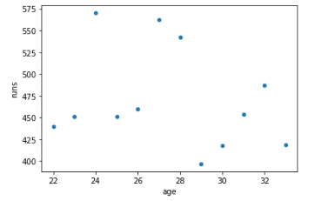
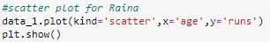
CORRELATION (between age and runs of batsman)
Suresh Raina

Slide 24
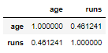
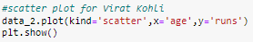
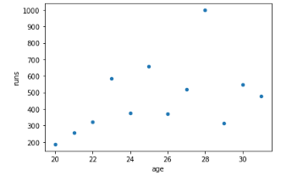
Virat Kohli

Slide 25
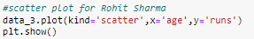
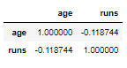
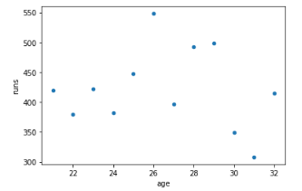
Rohit Sharma

Slide 26
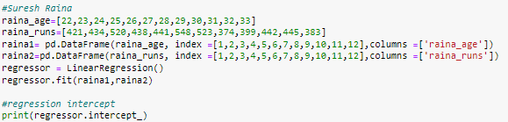
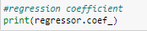
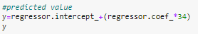
REGRESSION (age and runs of batsman)
Suresh Raina

Slide 27
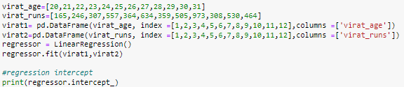
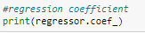
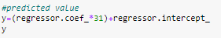
Virat Kohli

Slide 28
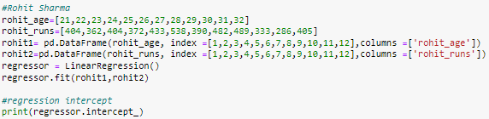
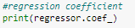
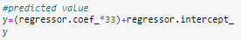
Rohit Sharma

Slide 29
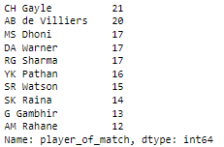
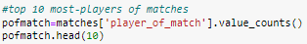
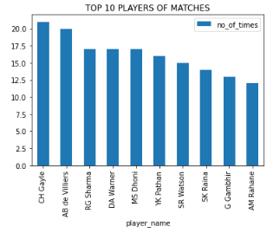
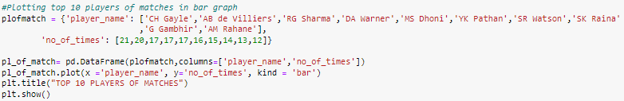
GRAPHICAL REPRESENTATION:
TOP 10 PLAYERS OF MATCHES

Slide 30
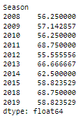


WINNING PERCENTAGE OF CSK(2008-19)

Slide 31



AVERAGE RUNS IN EACH OVER(1-20)

Slide 32




TOTAL MATCHES IN EACH CITY

Slide 33




TOTAL WINS BY EACH TEAM (2008-19)

Slide 34



PROBABILITY DISTRIBUTIONS :
BERNOULLI DISTRIBUTION :

Slide 35



UNIFORM DISTRIBUTION :

Slide 36

PROBABILITY :
PROBABILITY OF CSK GETTING MORE THAN 150 RUNS :

Slide 37




CONDITIONAL PROBABILITY :
PROBABILITY OF CSK WINNING AGAINST MI:

Slide 38



Slide 39





PROBABILITY OF MI WINNING AGAINST CSK:

Slide 40



PROBABILITY OF CSK WINNING IN THEIR HOMECITY:

Slide 41



PROBABILITY OF CSK WINNING IN OTHER CITY:

Slide 42



HYPOTHESIS TESTING :
Z – TEST :

Slide 43




Slide 44



Slide 45
CONCLUSION
MOST VALUABLE PLAYERS: CH Gayle,AB de Villiers ,DA Warner ,MS Dhoni & RG Sharma.
TOP PLAYERS- SK Raina,V Kohli & RG Sharma (highest runs till 2019)
CONSISTENT TEAM: Gujarat Lions
HIGHEST AVERAGE (runs per over) –
B Stanlake & S Sharma

Slide 46
CONCLUSION
HIGHEST AVERAGE (runs per match) – “CSK” and “Gujarat lions)
HIGHEST AVERAGE(runs per match)-
J Bairstow,DA Warner & H Gayle
CORRELATION: Raina-negative
Virat-positive
Rohit-negative
REGRESSION-Rohit Sharma predicted total runs to be scored on 2020: 394.849
Actual runs scored: 332

Slide 47
CONCLUSION
Winning percentage of csk is high during :2011,2013,2018
Most runs are taken during the last over with an average of 10 runs per over.
Mumbai hosted highest number of matches.
Mumbai won the most number of matches followed by csk and kkr

Slide 48
CONCLUSION
Winning the toss leads us to the chances of winning the match.
Mostly the team chooses fielding than batting when they win the toss.
Bowling first leads to the chances of winning.
Runs scored at first 10 overs is approximately same as the runs scored at last 5 overs.

Slide 49
CONCLUSION
TOP BATSMEN: Suresh Raina,Virat Kohli, Rohit Sharma, David Warner, Shikhar Dhawan
The probability of CSK hitting more than 150 runs is 63%.
Probability of CSK winning against MI is 11% VS Probability of MI winning against CSK is 15%
Probability of CSK winning in their homecity is 40% VS Probability of CSK winning in other city is 11%

Slide 50
THANK
YOU

